Slide 1

FY 2024-25 Budget & Tax Rate Presentation
Clifford Blackwell
City Manager
August 13, 2024

Slide 2
The Agenda for Today
- Budget Process
- Overview
- Tax Rate
- Major Operating Funds
- Capital Improvement Projects
- Supplemental Requests
- Feedback
Discussion Topics

Slide 3
Budget Process
October
New Fiscal Year
October – December
Year end review
Goal setting
January – February
Strategic/capital planning
March – May
Budget Preparation and coordination
Mid-year review
June – July
Budget Preparation
Tax Rate Calculation
August – September
Budget Workshops, Public Hearings, Adoption

Slide 4
WHY IS IT IMPORTANT?
- THE LAW REQUIRES IT….
Chapter 102 – Local Government Code
Sec. 102.002 Budget officer shall prepare each year a municipal budget to cover to the proposed expenditures of the municipal government for the succeeding year.
Sec. 102.006 The governing body … shall hold a public hearing on the proposed budget … shall set the hearing date …. shall provide for public notice of the hearing.
Sec. 102.007 The governing body shall take action to adopt the budget by record vote.
Chapter 26.04 – Tax Code
Sec. 26.01 Chief appraiser certifies tax roll by July 25.
Sec. 26.04 Submit certified tax roll to the governing body
Sec. 26.04 Defines No-New Revenue Rate and Voter-Approval Rate calculations as well as submit both rates to the governing body

Slide 5
GOVERNMENTAL FUND TYPES
OPERATING FUNDS $25,539,981
General Fund 53.4%
Water and Sewer Fund 39.0%
Debt Fund 5.5%
Drainage Fund 1.7%
Court Technology < 1%
Court Security < 1%
E911 Wireless < 1%
CAPITAL FUNDS $12,802,578
2016 GO Bond 34.0%
Grants Fund 24.5%
ARPA Fund 15.6%
Water/Sewer Impact 9.9%
Street Impact 7.0%
Capital Projects Fund 5.0%
Park Development 4.3%
Water Capital Projects Fund <1%

Slide 6
Budget Overview
TWO PROPOSED BUDGETS
OPERATING BUDGET (ALL FUNDS):
REVENUES $26,590,325
EXPENDITURES $25,539,981
$ 1,050,344 Surplus
CAPITAL IMPROVEMENT (ALL FUNDS):
REVENUES $ 6,949,783
EXPENDITURES $12,802,286
($ 5,852,503) Use of Fund Balance

Slide 7
What are the Residents Getting?
Sustained service levels across all Departments (no decrease in staff nor quality of services)
Enhanced commitment to Public Works
Expanding police presence in the schools
Furthering the commitment to sole-source paramedic program
Enhanced approach towards economic development
Commitment to a more efficient codification system, as well as a more efficient use of the council chambers
Investment in information technology software licensing as well as additional hardware
Investment in software that will improve customer service while addressing inefficiencies within Utility Billing and Municipal Court
Expansion of the city’s mass notification system
Allocation of additional resources for concrete repairs, equipment, training, vehicle maintenance

Slide 8
What are the Residents Getting?
Finish out of major capital projects that are currently work-in-progress:
All Abilities Park completion
Top of the Hills, Pavement improvement
Top of the Hills, Drainage improvement
ROW acquisition and utility relocations (E Bear Creek Road Expansion Project)
Replacement of the Outdoor Warning Siren system
Infiltration and Inflow Study
Upgrade water and wastewater lines (Cinnamon Springs)
Upgrade water line (Lin Dell Estates)
Investment/Commitment towards remodeling old city facilities'

Slide 9
TAX RATE & APPRAISAL VALUES

Slide 10
Property Tax Rate
The Tax Rate comprises of 2 components:
Maintenance & Operations Rate
Used to fund the operational cost associated with the General Fund.
Interest & Sinking Rate
Used to fund all [property] tax supported debt service

Slide 11
CURRENT TAX RATE
M & O RATE $0.481680
I & S RATE $0.083049
TOTAL TAX RATE $0.564729

Slide 12
Tax Rate Calculation
Property Tax Rates are Calculated as follows:
TAX LEVY ÷ NET TAXABLE VALUE × $100 ASSESSED VALUE = TAX RATE

Slide 13
No-New Revenue Rate Calculation

Slide 14
Voter Approval Rate Calculation

Slide 15
PUBLISHED TAX RATES Per Sec. 26.04 Tax Code
No-New Revenue $0.547525 per $100 AV
Voter Approval Rate $0.565015 per $100 AV
De Minimis Rate $0.576198 per $100 AV
Proposed Tax Rate $0.565015 per $100 AV

Slide 16
Average Residential Tax Levy Comparison

Slide 17
10-YR TAX RATE HISTORY

Slide 18
APPRAISAL VALUES
6.5%

Slide 19
Tax Levy History

Slide 20
MAJOR OPERATING FUNDS
General fund/ water fund/ drainage fund

Slide 21
GENERAL FUND
The General Fund is the general operating fund for the City. It is used to account for all financial resources except those required to be accounted for in other funds, such as the Water and Sewer Fund or Special Revenue Funds. All general tax revenues and other receipts that are not allocated by law or otherwise restricted to other funds are accounted for in this fund.
Administration
Council
Police/Fire
Streets
Parks/Recreation

Slide 22
General Fund Summary

Slide 23
General Fund Revenues

Slide 24
General Fund Revenues

Slide 25
General Fund Expenditures

Slide 26
General Fund
Total Expenditures $13,650,091 overall 7.6% increase
Significant changes:
Personnel Cost 4.5% increase
R & M 35.2% increase
Operating 24.2% increase
Events 11.8% increase
Contractual Services 8.2% increase
Debt (Lease cost) 39.8% increase

Slide 27
Significant Changes for General Fund
+ $381,159 Personnel Costs
Continuance of the City’s step plan per the pay scale adopted in 2022, amended in 2023
Proposed 2% COLA for all employees
Full year’s budget for all six single role paramedic positions
+ $137,500 Repairs & Maintenance
Increased repair cost to City facilities
Increased repair cost to City vehicles
Decreased beautification cost for IH35 flower bed as well as Heritage Park maintenance
Increased roadway repairs and maintenance in conjunction with the new concrete contract
+$163,037 Operating Expenses
Increased cost for software licenses (office 365, ESO Solutions, Windows CALs, etc.)
Increased auto insurance liability premium coverage
Added funding for State mandated Cancer and medical screening

Slide 28
Significant Changes for General Fund
+ $44,100 Utilities
Increase in the service contract for Telecommunications by 60% or $31K
Increase in Natural Gas costs
+$25,429 Events
Increased funding for City-wide Newsletters and small park events (Recreation Dept)
Funding for a City sponsorship in the Close-Up program +$21K
+ $158,280 Contractual Services
Investment in GIS Software implementation +$50K
Increased commitment to Economic Development initiatives +$35K
Increased Election Expense +$13K and Appraisal District fees +$11K
Active Net annual software fees/subscription services+$14K
Increase in EMS Billing Services (corresponds with EMS revenue)

Slide 29
Significant Changes for General Fund
+$56,979 Operating Debt
Increased cost due to two annual lease payments for Axon Fleet camera system
Reduced lease payment for Axon Taser 7 contract (free for one year)

Slide 30
Personnel Costs – General Fund

Slide 31
City Sponsored Events FY 2024-25

Slide 32
WATER AND SEWER FUND
The Water and Sewer fund is an enterprise fund that is funded only through user charges. Money is collected from residents and businesses in the form of utility payments and is used to pay rates/debt charged by wholesale providers such as the Trinity River Authority and the Dallas Water Utilities.
Water Operations
Sewer Operations
Meter Services
Utility Billing

Slide 33
Water and Sewer Summary

Slide 34
Water/Sewer Fund Revenues

Slide 35
Water and Sewer Fund

Slide 36
Water/Sewer Fund Expenditures

Slide 37
Water and Sewer Fund

Slide 38
Significant Changes for Water Fund
+ $14,229 Personnel Costs
Continuance of the City’s step plan per the pay scale adopted in 2022, amended in 2023
Proposed 2% COLA for all employees
+ $284,580 Supplies
Increased costs for new smart meters and replacement meters +$155K
Added new radios to the network for Public Works and UB staff +$95K
Added bubble chemicals for lift station cleaning +$12K
Increased heavy equipment maintenance $11K
+$126,500 Repairs & Maintenance
Increased focus on hydrant repairs, leak line repairs, sewer system repairs +$80K
Increased inspection cost for storage tank +$20K
Additional funding for generator maintenance (buildings) +$13K
Additional funding for preventive maintenance of heavy equipment

Slide 39
Wholesale Cost as % of total budget

Slide 40
DRAINAGE FUND
The Drainage fund is an enterprise fund that is funded only through user charges. Money is collected from residents and businesses in the form of utility payments and is used to maintain the City’s stormwater utility system.
Stormwater Operations

Slide 41
Drainage Fund Summary

Slide 42
Drainage Fund Operating Summary

Slide 43
Significant Changes for Water Fund
+ $6,417 Personnel Costs
Continuance of the City’s step plan per the pay scale adopted in 2022, amended in 2023
Proposed 2% COLA for all employees
+ $7,600 Supplies
Increased heavy equipment maintenance
+$30,000 Repairs & Maintenance
Increased funding for guardrail repairs, headwall repairs, inlet box repairs, RCP repairs, etc.
+$5,000 Capital Outlay
Increased funding for Gateway Estates drainage and bridge crossing
-$50,000 Net Capital Funding (Top of the Hills project)
Remove -$300,000 transfer for Top of the Hills capital projects
Add $250,000 to complete the Top of the Hills capital project (drainage portion)

Slide 44
FUNDED & UNFUNDED SUPPLEMENTAL REQUESTS
BUDGET PROPOSALS FOR NEW PROGRAMS AND STAFFING REQUESTS

Slide 45
Top 20 Department Request
Tyler Technology Conversion (Fin/UB/Court)
Salary Adjustments******
Community Engagement Administrator
File Serve Replacement
GIS
Court Clerk Position
Public Works Director Position
Police Records Clerk Position
Park & Recreation Supervisor Position
Fire Marshal Position
Right of Way Mowing
Re-classification for Police Records Coordinator
Planning Consultant
Gym Divider / Electric Wench
Engineer Tech / Project Manager
Command Vehicle (2- Fire) (1-Police)
Portable Radios
Fund Police Patrol Officer Position
Construction Inspector change to Project Manager
Generator Maintenance

Slide 46
Additional Departmental Request - Unfunded
Fire R&M Auto Increase by $20,000
Fire Sauna $14,500
Fire UTV EMS $60,000
Police Grey Key Devise $12,000
Police Range Trailer $9,000
Public Works Lift Station Degreaser $26,250
Public Works 6-yard Dump Truck $114,500
Public Works PCI Streets Rating $45,000
Public Works Sewer Jet Trailer $93,400
Public Works Backhoe Thumb Attachment $6,650
Public Works Truck $60,700
Replacement for Unit 90
Public Works Truck $52,950
Replacement for Unit 102
Public Works Trench Box $8,100
Human Resources ADA Officer $14,010.24

Slide 47
General Fund Summary

Slide 48
CAPITAL IMPROVEMENT PROGRAM
RECOMMENDED FUNDING FOR FY 2023-24 CIP

Slide 49
Capital Improvement Program

Slide 50
Capital Improvement Program

Slide 51
Capital Improvement Program

Slide 52
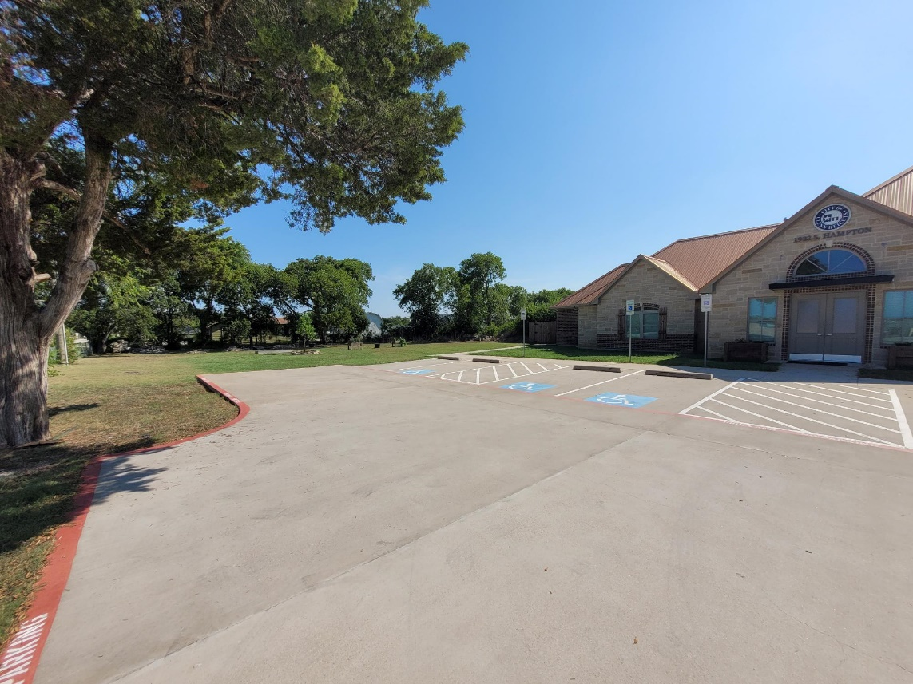
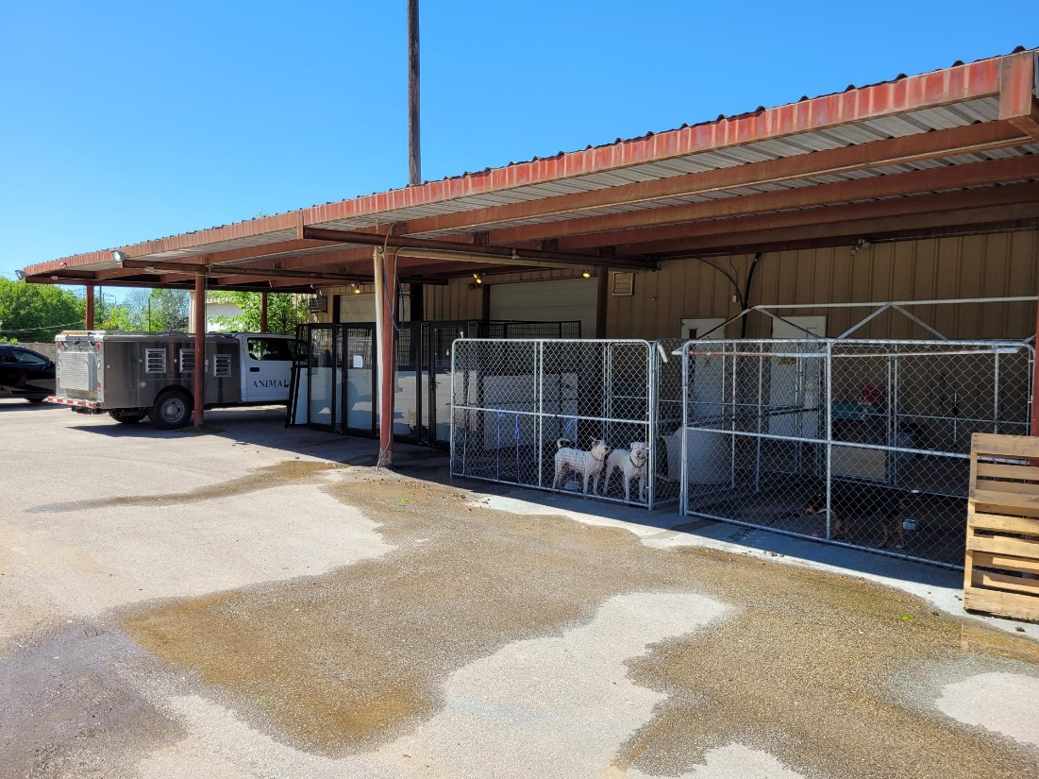
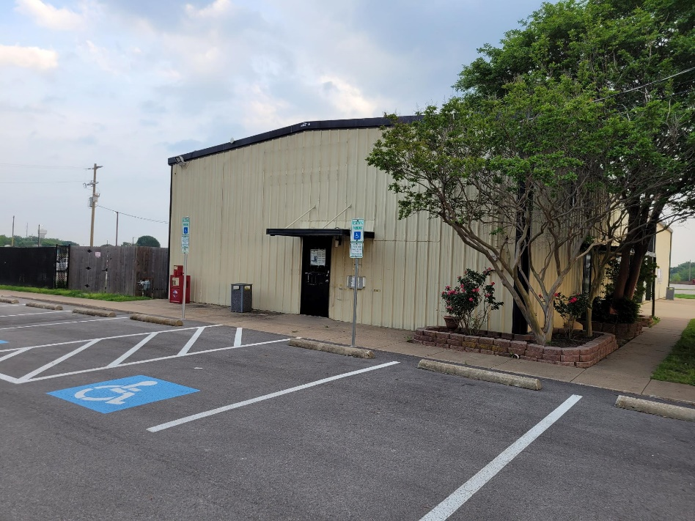
The plan for Old City facilities!
Family Life Center parking lot
Animal Shelter
Old City Hall

Slide 53
Questions?

Slide 54
Additional funding (compensation)

Slide 55
Next Steps
Consider the Proposed Tax Rate (Record Vote) - completed
Announce the Public Hearing dates, times, and location for:
Proposed Tax Rate September 3, 2024 - completed
FY 2023-24 Proposed Budget September 3, 2024 - completed
Conduct the Scheduled Public Hearings for the Proposed Budget, the Proposed Property Tax Rate, and the Amended Current Year Budget on September 3, 2024 @ 7:00 p.m.
First reading of the following ordinances:
Proposed Tax Rate September 3
FY 2023-24 Proposed Budget September 3
Second reading and adoption of the following ordinances:
Proposed Tax Rate September 10
FY 2023-24 Proposed Budget September 10

