Slide 1

City of Glenn Heights Town Hall Meeting
Clifford Blackwell & Brandi Brown,
October 4, 2025

Slide 2
Town Hall Overview
Discuss Guidelines
Election Timetable
Ethical Consideration
Propositions A – G
Bonds 101
Bond Propositions H – J
Q and A

Slide 3

Guidelines for City Bond Election
The city council of the City of Glenn Heights, Texas (the “City”) called a bond
election (August 12) at which one or more propositions will be submitted to the voters.
Election laws are nuanced and seem to change with every legislative cycle. As part of most legislative sessions, new legislation is proposed that impacts the ability of local governments to conduct a bond election.
As bond counsel to our clients, including the City, we stay current with respect to any newly enacted laws affecting bond elections, and of equal importance, we stay up-to-date with the Texas Attorney General’s interpretation of such laws.
Assuming voters approve the propositions that are proposed at the bond election, when the City issues the voter-authorized bonds, the Texas Office of the Attorney General (“OAG”) will review the transcript of the bond proceedings submitted by bond counsel, which will include a transcript of the bond election proceedings.

Slide 4
Guidelines for City Bond Election
OAG review of bond election proceedings will include confirmation of compliance with uniform election dates, separate proposition requirements, deadlines (calling, noticing, canvassing, etc.), contents of the action item calling election and notices of election, and canvassing the election.
There could be a long period of time between the election and when the bonds are issued. Obtaining updated documents at a later date could be difficult, especially if there are changes to City Council members and/or City staff.
This detailed OAG review is one of the many reasons why it is important for the City’s bond counsel (working in conjunction with the City attorney) to be involved in all aspects of calling and conducting a bond election.

Slide 5
Election Timetable

Slide 6
General Bond Election Timetable
 | Event | Time Required
City confers with financial advisor/bond counsel |  | At least 4 weeks before calling election
City explores possible polling locations and joint election agreement with election official |  | At least 3 weeks before calling election
City Council adopts an ordinance or resolution calling the election |  | Not more than 90 nor less than 78 days before election
Bond counsel orders translations (Spanish, etc.) |  | Immediately after calling the election
Bond counsel delivers ballot language to election official |  | Deadline determined by the election official
Bond counsel delivers notice of election to the county election official |  | Not later than 60 days prior to election
City publishes notice of election in English, Spanish, and other applicable languages |  | Not more than 30 days nor less than 10 days prior to election
Last day to register to vote |  | 30 days before the election
City posts notice of election (all applicable languages) prominently on the City’s website |  | Not later than 21 days prior to election until after election day
 | August 28, 2025 ₄

Slide 7
General Bond Election Timetable (cont.)
Event | Time Required
City posts sample ballot on the City’s website | Not later than 21 days prior to election until after election day
City posts notice of election (all applicable languages) at the City’s bulletin board used for posting meeting notices | Not later than 21 days prior to election until after election day
City posts notice of election (all applicable languages) at three public places in the City | Not later than 21 days prior to election until after election day
Early voting begins | [17 days prior to election day (November election)] / [12 days prior to election day (May election)]
Early voting ends | 4 days prior to election day
Election day | [1st Tuesday after the 1st Monday in November] / [1st Saturday in May]
August 28, 2025
5

Slide 8
General Bond Election Timetable (cont.)
Event | Time Required
City Council canvasses election returns | Not later than 11 days after election day and not earlier than the later of: (1) the 3rd day after election day; (2) the date the provisional ballots have been counted; or (3) the date that all timely cast overseas ballot have been counted
End of election contest period | Later of 30 days after canvassing or 15 days after electronic records available
August 28, 2025
6

Slide 9
Ethical Consideration

Slide 10
Ethical Considerations
It is important the City lead an “information-only” effort, as the City has a responsibility to inform all voters about the election but may not utilize City funds or resources to engage in electioneering (which is prohibited in all circumstances).
During bond elections, most complaints filed with the Texas Ethics Commission concern violations involving improper use of public resources for advocacy campaigns. This is a direct violation of election law.
The City should have bond counsel and/or the City attorney review bond election materials that the City intends to circulate to its voters. Other advisors to the City (e.g., financial advisors, engineers, architects, marketing firms, etc.) may offer input to a City during a bond election and any advice offered should be reviewed by the City attorney and/or bond counsel to ensure compliance with applicable laws.

Slide 11
Ethical Considerations (cont.)
Employees, officers and elected officials cannot use or authorize the use of public funds to advocate for (or against) a bond proposition.
Two areas where well-intentioned City officers, officials or employees run afoul of the rules:
Do not realize what they are doing is a use of City resources.
Do not realize what they are doing is “advocacy.”

Slide 12

State agencies that monitor election practices
Texas Ethics Commission (TEC)
Administers and enforces Election Code.
Interprets the rules prohibiting certain political
advertising.
Has the authority to impose fines.
Texas Attorney General
Investigative Powers.
Cease and Desist Orders.
Legal Opinions.
Texas Secretary of State
Chief Election Officer of the State.

Slide 13
Propositions A - G

Slide 14
Proposition A
§ 2.01 Number, Selection, Term of Office and Compensation.
Shall Section 2.01 of the Home Rule Charter be amended by extending the terms of office of the mayor and city council members from three (3) years to four years (4), extending the period of ineligibility of term-limited members from three (3) to four (4) years, and adding transitional language such that four-year terms of office will begin for the mayor and councilmembers elected in the November, 2026, election.

Slide 15
Proposition B
§ 2.01 Number, Selection, Term of Office and Compensation.
Shall Section 2.01 of the Home Rule Charter be amended to provide for compensation for the Mayor of $1,000 monthly and for Councilmembers of $500 monthly.
There is no current compensation.

Slide 16
Fiscal Impact of Proposition B

Slide 17
Proposition C
§ 2.03 Qualifications.
Shall Section 2.03 of the Home Rule Charter be amended to disqualify candidacy for a seat on the City Council for persons who have previously been removed by the Council for misconduct.

Slide 18
Proposition D
§ 2.11 Procedure to Enact Legislation.
Shall Section 2.11 of Article 2 of the Home Rule Charter be amended to repeal the requirement that all ordinances must be considered at two separate City Council meetings prior to adoption.
This will amend the Charter to state that Ordinances may be adopted
at the first reading.

Slide 19
Proposition E
§ 3.06 Election Runoff. Election by Plurality.
Shall Section 3.06 of Article 3 of the Home Rule Charter be amended to provide that elections for Mayor and Councilmembers be by plurality instead of majority voting, such that the candidate receiving more votes than any other candidate will be declared elected.
With majority voting, a candidate must receive more than 50% of the vote, if no candidate achieves that amount, then a runoff will occur between the top 2 candidates. With plurality voting, the election is decided solely based on who receives the most votes.

Slide 20
Proposition E Continued
Election Day
Candidate 1 | 45% of votes cast
Candidate 2 | 30% of votes cast
Candidate 3 | 25% of votes cast
Majority: Candidates 1 and 2 would participate in a Runoff Election
Plurality: Candidate 1 would be declared the winner

Slide 21
Proposition F
§ 5.11 City Secretary.
Shall Section 5.11 of the Home Rule Charter be amended to authorize the City Council to appoint a Council Liaison.

Slide 22
Fiscal Impact of Proposition F
The actual fiscal impact will depend on the pay grade classification of the position if this proposition passes.
The City Council will then determine the classification, job description, and rate of pay.
Pay grade classifications are part of a spectrum of pay ranges from a minimum salary of $41,003 to a maximum salary $252,661.

Slide 23
Proposition G
§ 13.06 Notice of Claim.
Shall Section 13.06 of the Home Rule Charter be amended to provide that notices of claims against the City shall be filed within 45 days of the incident giving rise to the claim.
Currently, a person/ entity has 90 days to file a claim.

Slide 24
General Obligation Bonds

Slide 25
Property Tax Rate
The Tax Rate comprises of 2 components:
Maintenance & Operations Rate
Used to fund the operational cost associated with the General Fund.
Interest & Sinking Rate
Used to fund all [property] tax supported debt service

Slide 26
ADOPTED TAX RATE
M & O RATE $0.495670
I & S RATE $0.067125
TOTAL TAX RATE $0.562795

Slide 27
Tax Rate Calculation
Property Tax Rates are Calculated as follows:
TAX LEVY ÷ NET TAXABLE VALUE × $100 ASSESSED VALUE = TAX RATE

Slide 28
General Bond Items
General obligation bond is similar to a home mortgage
Contract to repay borrowed money over time at a fixed, tax-exempt interest rate
Bonds can be used for new construction, repair/renovation, acquisitions, and equipment
Proceeds cannot be used for any projects not contained within the bond election propositions
Proceeds cannot be used for day-to-day operations of the City
How are bonds repaid?
The City may levy an Interest and Sinking Fund (“I&S”) tax rate, which can only be used to repay debt
City may use other legally available revenues, such as utility revenues, to repay the bonds
How does a bond election work?
Simple majority for passage; gives the City Council the right but not the obligation to issue bonds
If approved by voters, bonds may be sold in one series or in multiple series
If approved by voters, generally the AG likes to see issuance within 10 years (no specific rule on issuance timeframe)

Slide 29
General Bond Items (cont.)
What will the interest rate be?
Interest rates are set once the bonds are sold and are based on several factors, including 1) the City’s credit rating and 2) the bond market environment at the time of pricing
What is the City’s credit rating?
“AA-” by Standard & Poor’s
What is the term/payback period of a bond?
Bonds may be repaid over a period of 40 years, although the City is planning to repay bonds over a 20 year period
Once set, can interest rates on the new bonds ever change?
When the bonds are priced, a call date is included
Gives the City the ability to take the bonds away from the investors on the call date or anytime thereafter
City can refinance the bonds at lower interest rates, if the market environment is conducive (similar to refinancing a home mortgage)
City can also use funds on hand to pay off the bonds early, avoiding interest cost

Slide 30
Bond Sizing Factors and Assumptions
I&S tax rate
Current fiscal year 2025 I&S tax rate is 7.7518 cents
Newly adopted I&S tax rate is now 6.7125 cents.
Tax base
Average annual growth rate over the past 5 years is ~ 20.8%
Finance plan assumption: 2.5% annual growth for fiscal years 2027 and 2028, flat thereafter
Interest rates
Finance plan assumption: 4.90%
Repayment term
Finance plan assumption: 20 Years

Slide 31
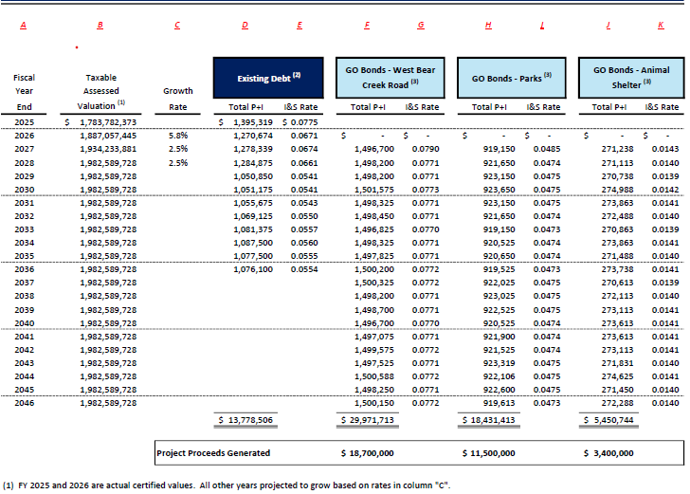

Slide 32
Proposition H - J

Slide 33
Proposition H
THIS IS A TAX INCREASE
“The issuance of $3,400,000 general obligation bonds for an animal shelter and animal control facilities, and the imposition of a tax sufficient to pay the principal of and interest on the bonds.”
FISCAL IMPACT
~ $0.0143 INCREASE ON TAX RATE
MARKET VALUE HOME = $450,000
TAX VALUE HOME = $400,000
Current Tax Rate = $0.562795
CURRENT LEVY = $2,251.18
New Tax Rate (potentially) $0.577095
NEW LEVY = $2,308.38 DIFF $ 57.20

Slide 34
Proposition I
THIS IS A TAX INCREASE
“The issuance of $11,500,000 general obligation bonds for park and recreational facilities and the imposition of a tax sufficient to pay the principal of and interest on the bonds.”
FISCAL IMPACT
~ $0.0485 INCREASE ON TAX RATE
MARKET VALUE HOME = $450,000
TAX VALUE HOME = $400,000
Current Tax Rate = $0.562795
CURRENT LEVY = $2,251.18
New Tax Rate (potentially) $0.611295
NEW LEVY = $2,445.18 DIFF $ 194.00

Slide 35
Proposition J
THIS IS A TAX INCREASE
“The issuance of $18,700,000 general obligation bonds for street improvements and the imposition of a tax sufficient to pay the principal of and interest on the bonds.”
FISCAL IMPACT
~ $0.079 INCREASE ON TAX RATE
MARKET VALUE HOME = $450,000
TAX VALUE HOME = $400,000
Current Tax Rate = $0.562795
CURRENT LEVY = $2,251.18
New Tax Rate (potentially) $0.641795
NEW LEVY = $2,567.18 DIFF $ 316.00

Slide 36
Fiscal Impact if all 3 bonds are issued altogether
FISCAL IMPACT (if all three propositions pass)
~ $0.1418 INCREASE ON TAX RATE
MARKET VALUE HOME = $450,000
TAX VALUE HOME = $400,000
Current Tax Rate = $0.562795
CURRENT LEVY = $2,251.18
New Tax Rate (potentially) $0.704595
NEW LEVY = $2,818.38
DIFF $ 567.20

Slide 37
Where to find additional information?

Slide 38
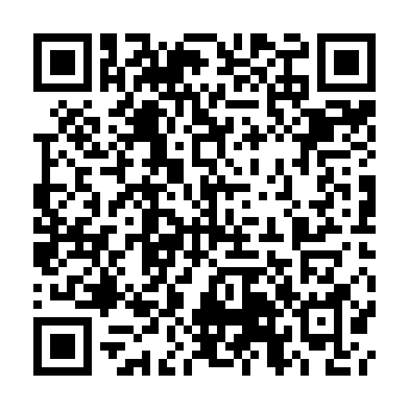
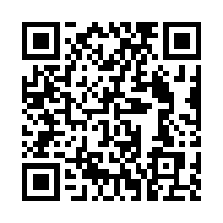
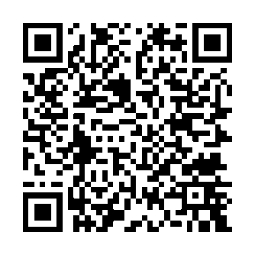
Visit these sites for additional information
City of Glenn Heights Election Page
Sample Ballot (Dallas and Ellis Counties)
Early Voting and Election Day Information (Dates, Hours, & Polling Locations)
All information in English, Spanish, and Vietnamese
Dallas County Elections Department
Ellis County Elections

Slide 39
Questions
Thank you!

